Slide 1
New Product Sales Methods analysis
Pens and Printers
Katherine P.

Slide 2
ABOUT US
New Product Sales Methods
Email
Customers in this group received an email when the product line was launched, and further email three weeks later. This required very little work for the team.
Pens and Printers was founded in 1984 and offers high quality office products to large organizations. We are a trusted supplier offering everything from pens and notebooks to desk chairs and monitors. We have a long-standing relationship of trust with their customers. However, as the way customers shop is changing, we are looking to adapt our sales methods to launch a new line of products.
Call
Customers in this group were called by a member of the sales team. On average members of the team were on the phone for around thirty minutes per customer.
Email and call
Customers in this group first received the email with product information, and a week later, the sales team called them to discuss their needs and how this new product could help them in their work. The email required little effort from the team; the call lasted approximately ten minutes per customer.

Slide 3
DATA ANALYSIS
DATA VALIDATION
Description validation and cleaning steps for every column in the data
EXPLORATORY ANALYSIS
Analysis to answer the questions of the Sales Representatives and description of findings
METRICS FOR THE BUSINESS
Recommendation of metrics that the business should monitor to achieve its objectives
SUMMARY
Final summary including recommendations that the business should undertake

Slide 4
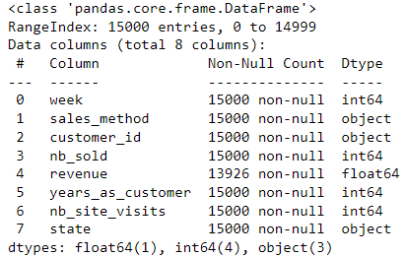

Data validation
The initial dataset contains 15,000 rows and 8 columns. After data validation, the number of records was reduced to 13,926.
With the exception of 'revenue', 'years_as_customer', and 'sales_method', the variables fit the data frame description.
It was necessary to standardize the way sales methods were captured and adjust the maximum possible value for 'years_as_customer’.
Records with null values ​​for 'revenue' were excluded from the analysis as they were considered ineffective sales.

Slide 5
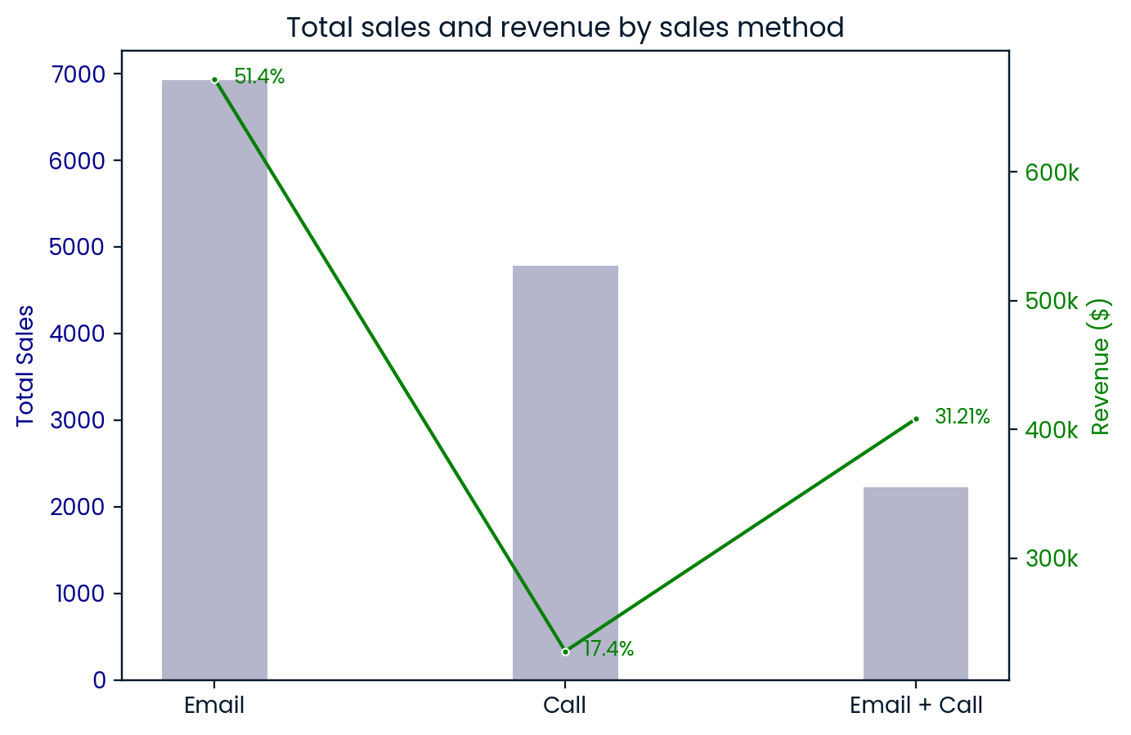
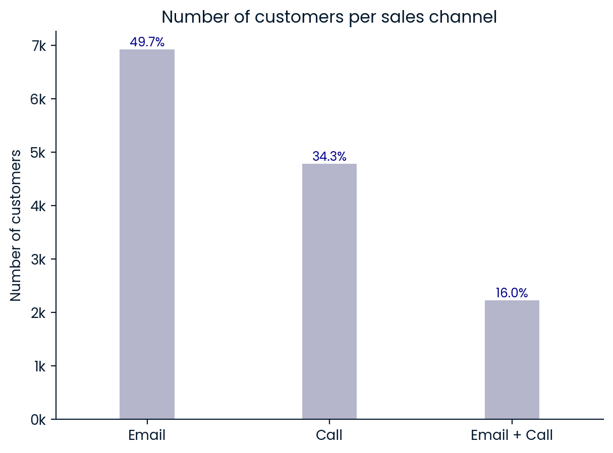
EXPLORATORY ANALYSIS
How the customers are spread out?
Email (~50 %), Call 34 %, Email + Call 16 %.
What about the revenue?
Email: 6922 sales, $672000 (51%).
Email + call: 2223 sales, $408000 USD (31 %)
Call: 4781 sales, $228000 USD (17 %)

Slide 6
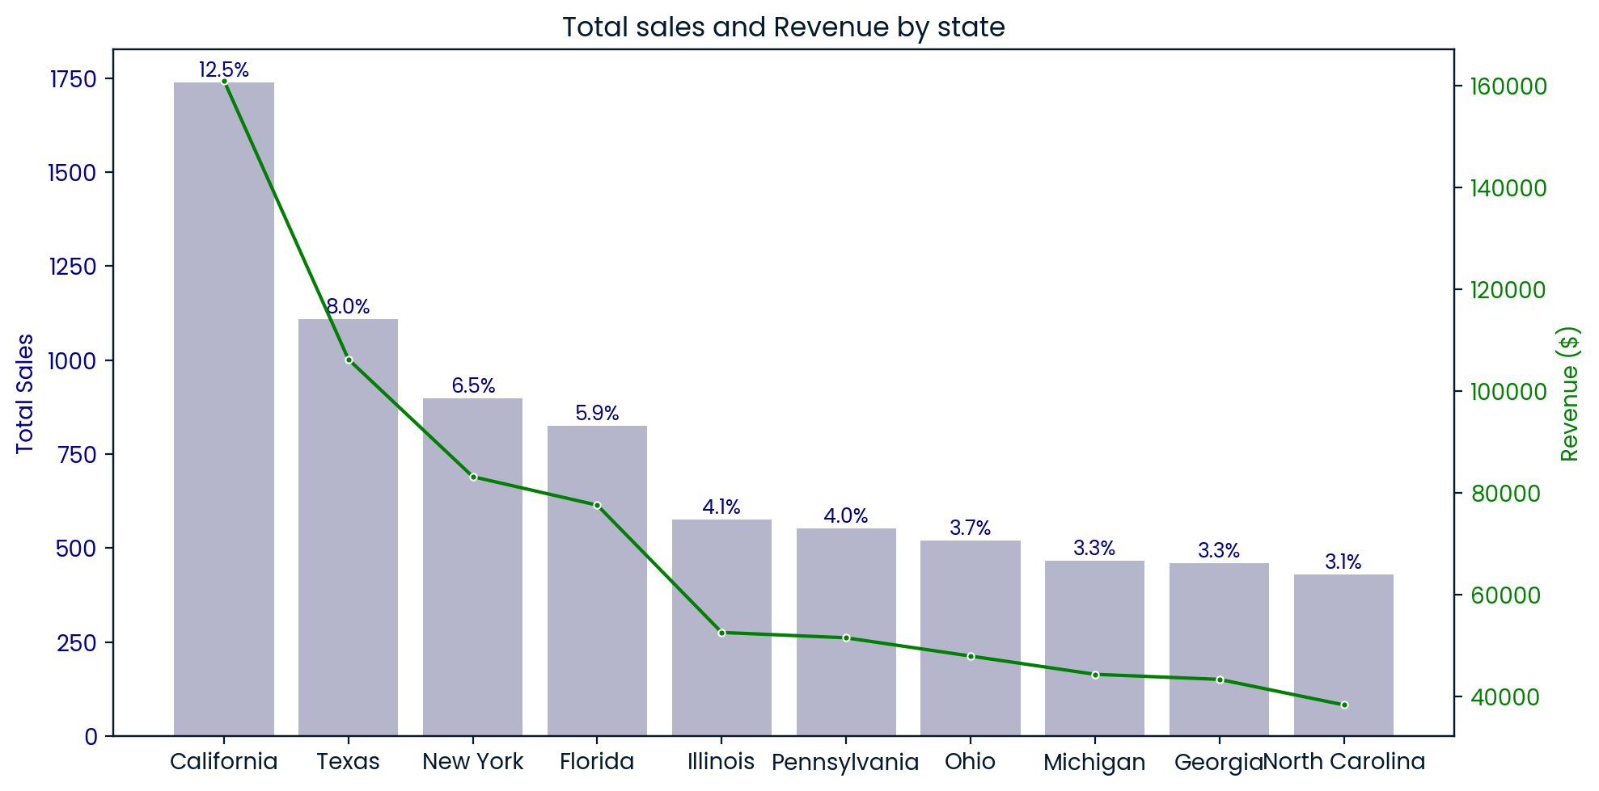
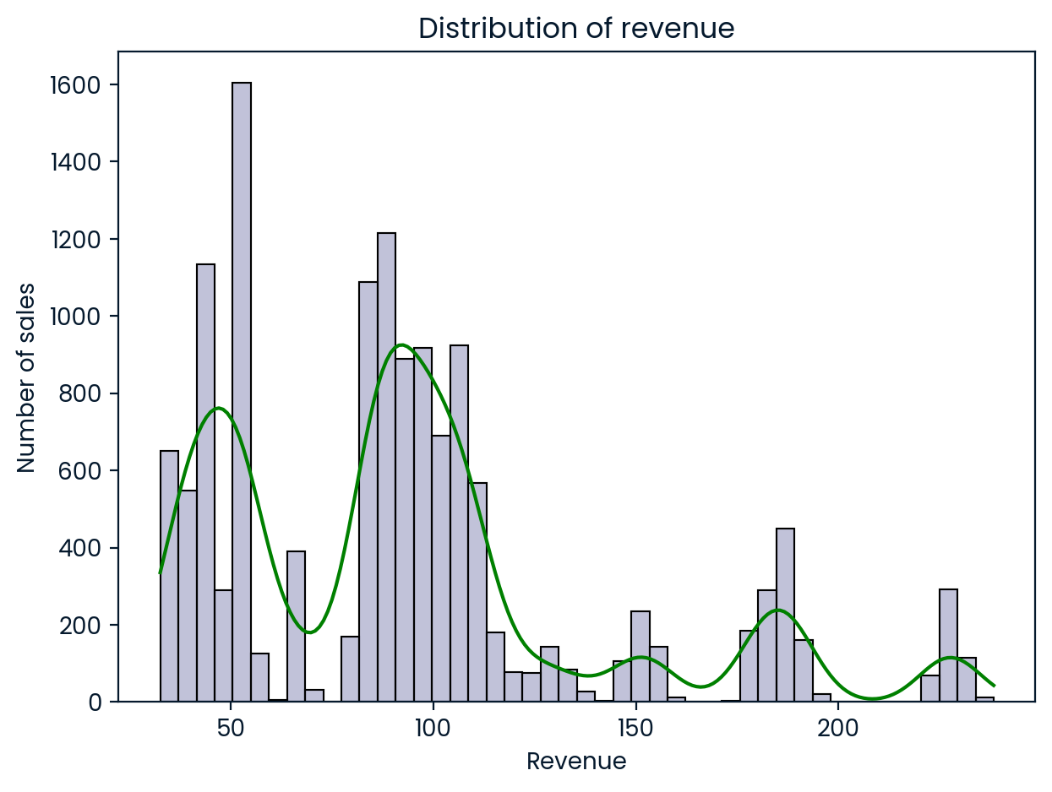
EXPLORATORY ANALYSIS
Where are the customers located?
California 12.5 %, Texas 8 %, New York 6.5 %, and Florida 5.9 %.
How the revenue from sales is spread out?
Revenue distribution with peaks around 50 and 100 USD.

Slide 7
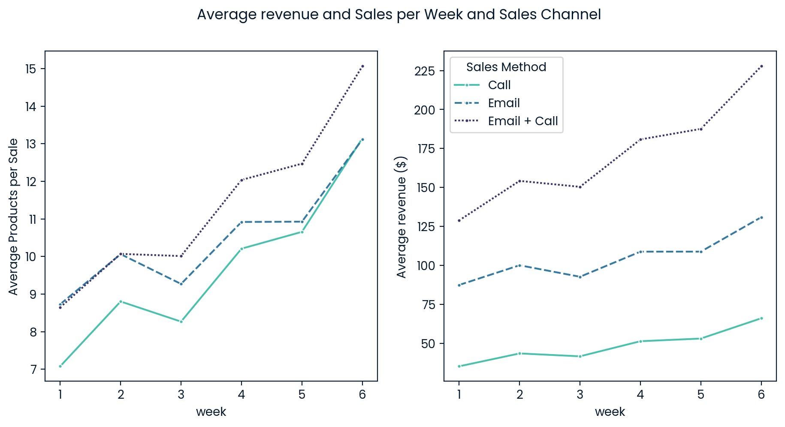
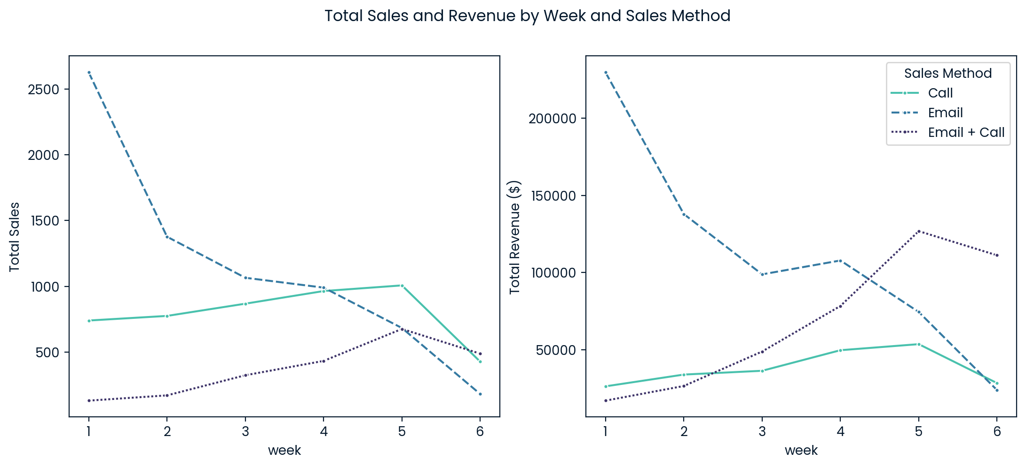
EXPLORATORY ANALYSIS
What about sales over time?
Email sales decline over time. Although phone sales remain higher, their high cost reduces profitability. In contrast, sales and revenue from the combined channel (Email + Call) increase, becoming the top-performing method by weeks 5 and 6. However, phone sales drop sharply in week 6.
Over time, the average revenue per sale increased across all channels. The combined method had the highest revenue, followed by email, and phone had the lowest. By the end of the analysis, email and phone averaged 13 products per sale, while the combined method reached 15.

Slide 8
How to track sales performance?
KPI 1: Weekly revenue share BY channel
KPI 2: Week over week revenue growth %
This shows which sales method works better.
This helps us know if sales are growing or not.
Sales method | Call | Email | Email + Call
week
1 | 9.59% | 84.22% | 6.19%
2 | 17.06% | 69.62% | 13.32%
3 | 19.72% | 53.76% | 26.52%
4 | 21.04% | 45.74% | 33.22%
5 | 21.01% | 29.20% | 49.79%
6 | 17.32% | 14.53% | 68.14%
Week | Revenue | Pct change
1.00 | 272810.06 | 0.00
2.00 | 198059.82 | -27.00
3.00 | 183776.55 | -7.00
4.00 | 235678.56 | 28.00
5.00 | 254701.28 | 8.00
6.00 | 163111.74 | -36.00
In the first four weeks, the email channel was the main revenue generator. However, in weeks 5 and 6, the combined channel (email - calls) dominated, contributing close to 50% and 68% of revenues, respectively.
The first three weeks showed a sustained drop in revenues, followed by a recovery in the fourth and fifth weeks. However, in the sixth week, revenues fell sharply by 36%.

Slide 9
SUMMARY
It is recommended to use the combined method as the main sales channel and email as a second option. Keeping contact with customers is key to building loyalty and improving sales.
To measure results, it’s important to track weekly changes in total revenue and the share of revenue by channel. Also, data collection and validation should be improved.
THANK YOU

